Slide 1
Int 306 dbms
data modeling

Slide 3
Data models Type
Hierarchical Model
Network Model
Relational Model
Object Oriented Model
Entity-relationship Model
Record based
Object Based

Slide 4
Hierarchical Model
This database model organizes data into a tree-like-structure, with a single root, to which all the other data is linked. The hierarchy starts from the Root data, and expands like a tree, adding child nodes to the parent nodes.

Slide 5
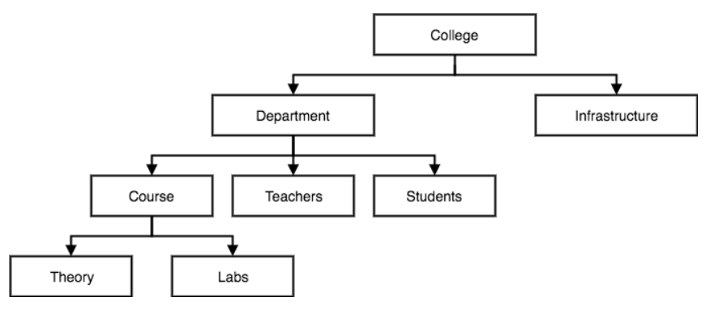
Hierarchical Model

Slide 6
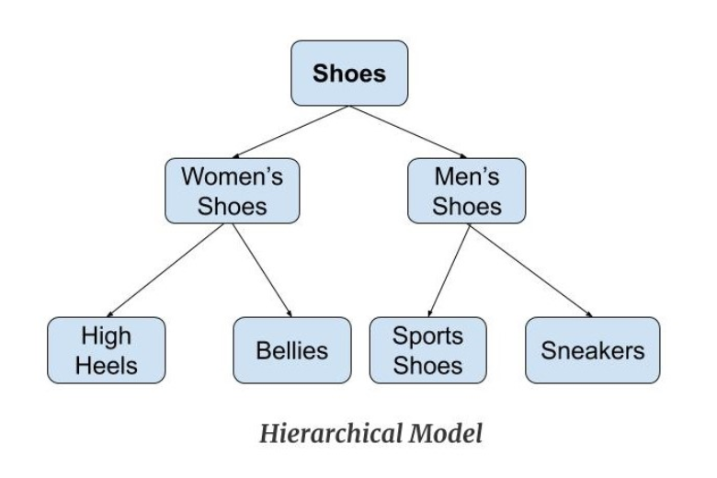
Hierarchical Model

Slide 7
Features of a Hierarchical Model
One-to-many relationship: The data here is organised in a tree-like structure where the one-to-many relationship is between the datatypes. Also, there can be only one path from parent to any node. Example: In the previos example, if we want to go to the node sneakers we only have one path to reach there i.e through men's shoes node.
Parent-Child Relationship: Each child node has a parent node but a parent node can have more than one child node. Multiple parents are not allowed.
Deletion Problem: If a parent node is deleted then the child node is automatically deleted.
Pointers: Pointers are used to link the parent node with the child node and are used to navigate between the stored data. Example: In the above example the 'shoes' node points to the two other nodes 'women shoes' node and 'men's shoes' node.

Slide 8
Advantages of a Hierarchical Model
It is very simple and fast to traverse through a tree-like structure.
Any change in the parent node is automatically reflected in the child node so, the integrity of data is maintained.

Slide 9
Disadvantages of a Hierarchical Model
Complex relationships are not supported.
As it does not support more than one parent of the child node so if we have some complex relationship where a child node needs to have two parent node then that can't be represented using this model.
If a parent node is deleted then the child node is automatically deleted.

Slide 10
Network Model
This is an extension of the Hierarchical model. In this model data is organised more like a graph, and are allowed to have more than one parent node.
In this database model data is more related as more relationships are established in this database model. Also, as the data is more related, hence accessing the data is also easier and fast. This database model was used to map many-to-many data relationships.

Slide 11
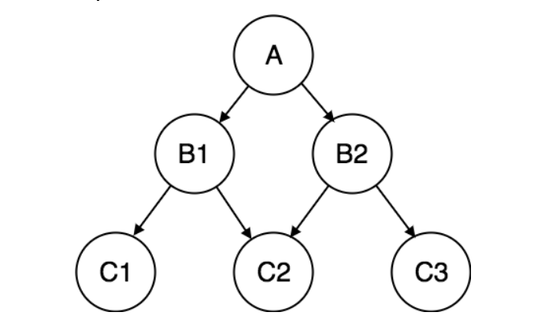
Network Model continue..

Slide 12
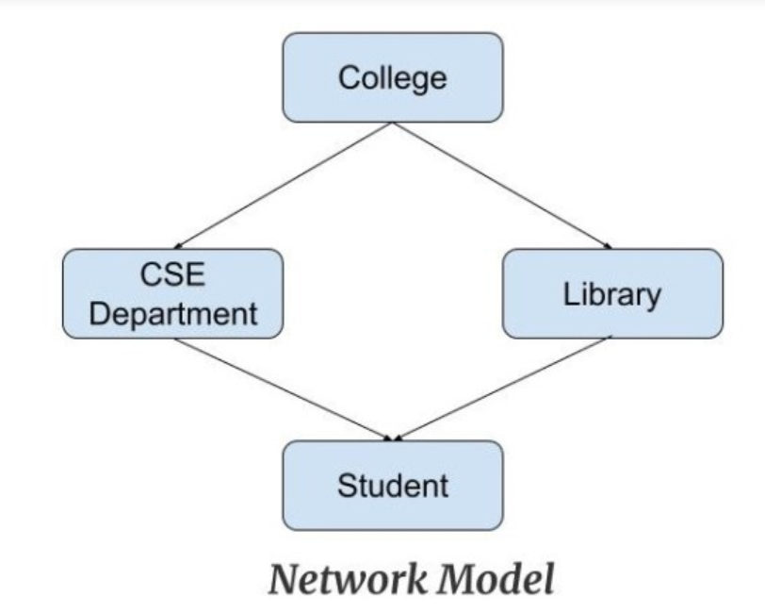
Network Model continue..

Slide 13
Features of a Network Model
Ability to Merge more Relationships: In this model, as there are more relationships so data is more related. This model has the ability to manage one-to-one relationships as well as many-to-many relationships.
Many paths: As there are more relationships so there can be more than one path to the same record. This makes data access fast and simple.
Circular Linked List: The operations on the network model are done with the help of the circular linked list. The current position is maintained with the help of a program and this position navigates through the records according to the relationship.

Slide 14
Advantages of Network Model
The data can be accessed faster as compared to the hierarchical model. This is because the data is more related in the network model and there can be more than one path to reach a particular node. So the data can be accessed in many ways.
As there is a parent-child relationship so data integrity is present. Any change in parent record is reflected in the child record.

Slide 15
Disadvantages of Network Model
As more and more relationships need to be handled the system might get complex. So, a user must be having detailed knowledge of the model to work with the model.
Any change like updation, deletion, insertion is very complex.

Slide 16
Relational Model
In this model, data is organised in two-dimensional tables and the relationship is maintained by storing a common field.
This model was introduced by E.F Codd in 1970, and since then it has been the most widely used database model, in fact, we can say the only database model used around the world.
The basic structure of data in the relational model is tables. All the information related to a particular type is stored in rows of that table.
Hence, tables are also known as relations in relational model.

Slide 17
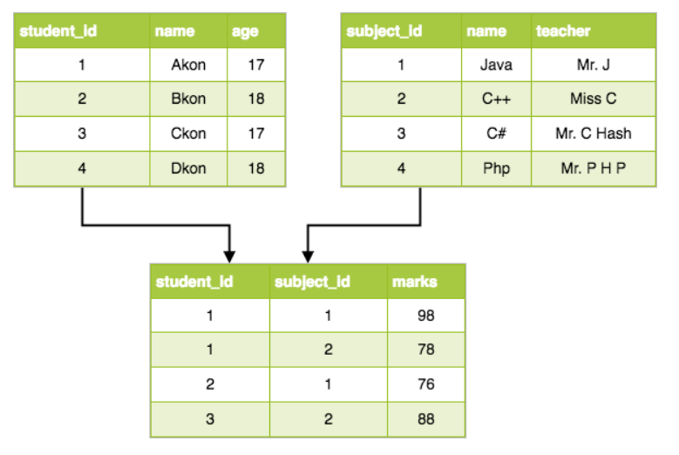
Relational Model

Slide 18
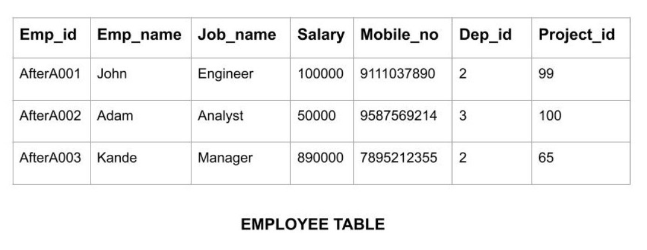
Relational Model

Slide 19
Features of Relational Model
Tuples: Each row in the table is called tuple. A row contains all the information about any instance of the object. In the above example, each row has all the information about any specific individual like the first row has information about John.
Attribute or field: Attributes are the property which defines the table or relation. The values of the attribute should be from the same domain. In the above example, we have different attributes of the employee like Salary, Mobile_no, etc.

Slide 20
Advantages of Relational Model
Simple: This model is more simple as compared to the network and hierarchical model.
Scalable: This model can be easily scaled as we can add as many rows and columns we want.
Structural Independence: We can make changes in database structure without changing the way to access the data. When we can make changes to the database structure without affecting the capability to DBMS to access the data we can say that structural independence has been achieved.

Slide 21
Disadvantages of Relational Model
Hardware Overheads: For hiding the complexities and making things easier for the user this model requires more powerful hardware computers and data storage devices.
Bad Design: As the relational model is very easy to design and use. So the users don't need to know how the data is stored in order to access it. This ease of design can lead to the development of a poor database which would slow down if the database grows.
But all these disadvantages are minor as compared to the advantages of the relational model. These problems can be avoided with the help of proper implementation and organisation.

Slide 22
object-oriented data model
The real-world problems are more closely represented through the object-oriented data model. In this model, both the data and relationship are present in a single structure known as an object. We can store audio, video, images, etc in the database which was not possible in the relational model(although you can store audio and video in relational database, it is adviced not to store in the relational database). In this model, two are more objects are connected through links. We use this link to relate one object to other objects. This can be understood by the example given below.

Slide 23
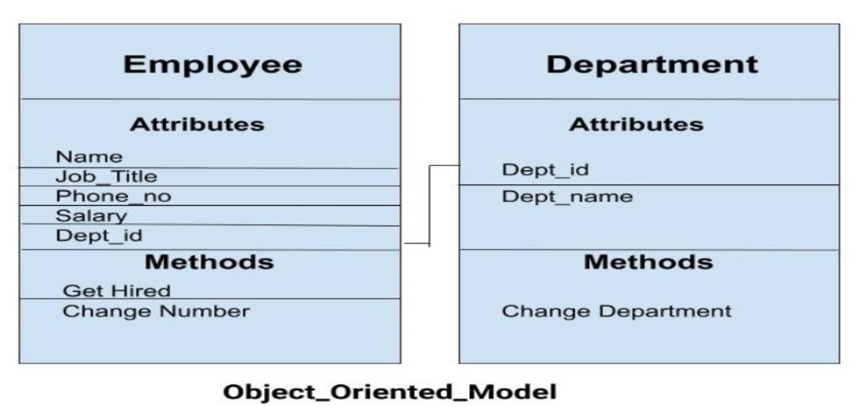
object-oriented data model

Slide 24
object-oriented data model
In the previous example, we have two objects Employee and Department. All the data and relationships of each object are contained as a single unit. The attributes like Name, Job_title of the employee and the methods which will be performed by that object are stored as a single object. The two objects are connected through a common attribute i.e the Department_id and the communication between these two will be done with the help of this common id.

Slide 25
object-oriented data model
In the previous example, we have two objects Employee and Department. All the data and relationships of each object are contained as a single unit. The attributes like Name, Job_title of the employee and the methods which will be performed by that object are stored as a single object. The two objects are connected through a common attribute i.e the Department_id and the communication between these two will be done with the help of this common id.

Slide 26
ER model
In this database model, relationships are created by dividing object of interest into entity and its characteristics into attributes.
Different entities are related using relationships.
E-R Models are defined to represent the relationships into pictorial form to make it easier for different stakeholders to understand.

Slide 27
ER model
Entities: Entity is a real-world thing. It can be a person, place, or even a concept. Example: Teachers, Students, Course, Building, Department, etc are some of the entities of a School Management System.
Attributes: An entity contains a real-world property called attribute. This is the characteristics of that attribute. Example: The entity teacher has the property like teacher id, salary, age, etc.
Relationship: Relationship tells how two attributes are related. Example: Teacher works for a department.

Slide 28
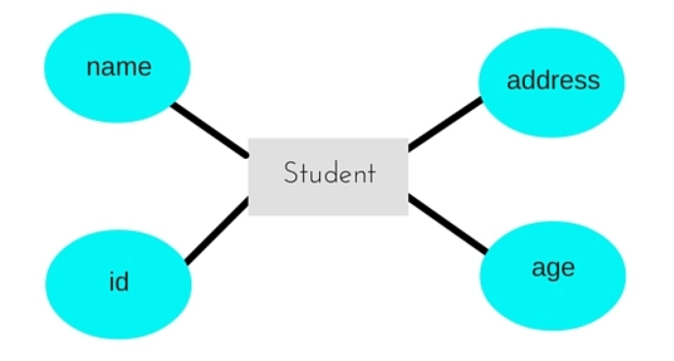
ER model continue..

Slide 29
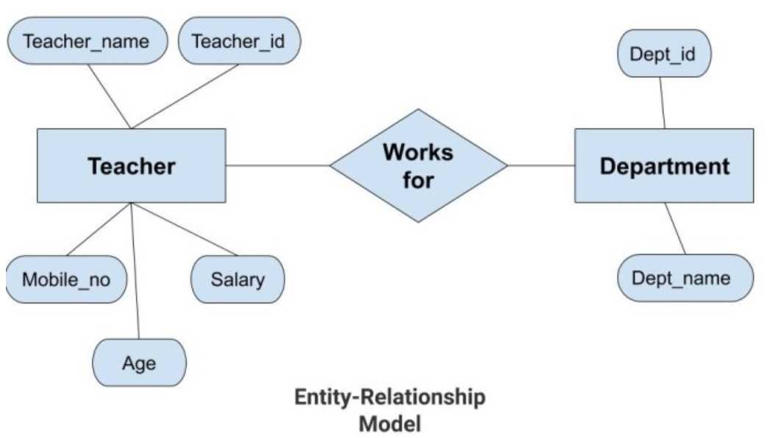
ER model continue..

Slide 30
ER model continue..
In the previous diagram, the entities are Teacher and Department. The attributes of Teacher entity are Teacher_Name, Teacher_id, Age, Salary, Mobile_Number. The attributes of entity Department entity are Dept_id, Dept_name. The two entities are connected using the relationship. Here, each teacher works for a department.

Slide 31
Features of ER Model
Graphical Representation for Better Understanding: It is very easy and simple to understand so it can be used by the developers to communicate with the stakeholders.
ER Diagram: ER diagram is used as a visual tool for representing the model.
Database Design: This model helps the database designers to build the database and is widely used in database design.

Slide 32
advantages of ER Model
Simple: Conceptually ER Model is very easy to build. If we know the relationship between the attributes and the entities we can easily build the ER Diagram for the model.
Effective Communication Tool: This model is used widely by the database designers for communicating their ideas.
Easy Conversion to any Model: This model maps well to the relational model and can be easily converted relational model by converting the ER model to the table. This model can also be converted to any other model like network model, hierarchical model etc.

Slide 33
Disadvantages of ER Model
No industry standard for notation: There is no industry standard for developing an ER model. So one developer might use notations which are not understood by other developers.
Hidden information: Some information might be lost or hidden in the ER model. As it is a high-level view so there are chances that some details of information might be hidden.

Slide 34

Any DOUBT ?

